Slide 1
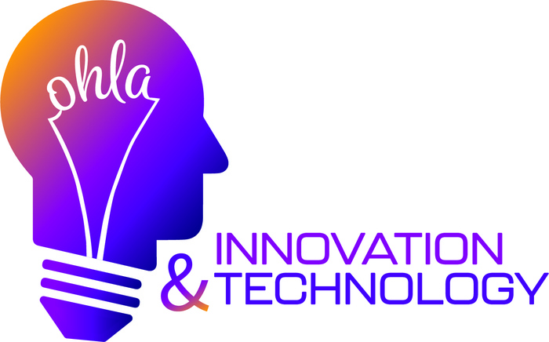

Slide 2
Introduction
AI-Powered Video Surveillance in the Hospitality Industry
Enhancing Security, Reducing Risks, Improving Guest Experience
March 27, 2025
10:00 AM - 11:30 AM EST
OHLA President & CEO: Joe Savarise
Meeting Chair: Ketan Pema
AI Video Surveillance Expert: Gaby Batshoun

Slide 3
Introduction & Context
How has AI-powered video surveillance evolved in recent years?
Why is AI surveillance essential for hotel security today?
Notes:
Ketan How has AI-powered video surveillance evolved in recent years?
Gabby
AI surveillance has shifted from simple motion detection to real-time analysis using deep learning and behavioral analytics.
AI can now recognize patterns, objects, and human behaviors to differentiate between normal activity and potential threats.
Advancements in computer vision and edge computing allow for faster, more accurate threat detection.
Cloud-based AI enables remote access, real-time alerts, and better data storage options.
*************************************
Ketan Why is AI surveillance becoming a critical tool for the hospitality industry?
Gabby
Rising vandalism, theft, and unauthorized access in hotels necessitate advanced security measures.
AI can proactively detect suspicious behavior before an incident occurs.
Improves operational efficiency, reducing the need for constant human monitoring.
Enhances guest safety and experience while ensuring regulatory compliance.

Slide 4
Understanding AI Surveillance Capabilitiesabilities
AI & Guest Behavior:
How does AI identify security threats vs. normal guest activity?
Real-Time Detection:
Can AI detect weapons or suspicious activity instantly?
Facial & License Plate Recognition:
How do they enhance hotel security while ensuring privacy?
Reducing False Alarms:
How does AI improve accuracy over motion-detection cameras?
Notes:
Evolution of AI Surveillance
Ketan
How does AI differentiate between normal guest behavior and potential security threats?
Gabby
AI analyzes movement patterns to distinguish between normal guest activities and unusual behaviors (e.g., loitering, aggressive actions).
Uses machine learning models trained on hotel-specific scenarios to adapt to different environments.
Can identify crowd formations, sudden movements, or unauthorized access to restricted areas.
****************************************
Ketan
Can AI surveillance detect weapons or suspicious activity in real-time?
Gabby
Yes, AI-powered cameras can detect firearms, knives, and other weapons using object recognition technology.
Alerts security staff instantly when a weapon is identified, allowing for a quicker response.
Can analyze suspicious body language, such as someone concealing an object.
*******************
Ketan
What role do facial recognition and license plate recognition play in hotel security? How can hotels use them responsibly?
Gabby
Facial recognition helps identify known criminals, VIP guests, or banned individuals.
License plate recognition ensures secure parking areas by detecting unauthorized vehicles.
To use responsibly, hotels should:
Obtain guest consent when required.
Comply with local privacy laws (e.g., GDPR, CCPA).
Store data securely and limit access to authorized personnel.
**************************************
Ketan
How does AI help reduce false alarms compared to traditional motion-detection cameras?
Gabby
AI analyzes movement contextually, differentiating between a guest walking and someone attempting forced entry.
Uses multi-factor analysis (e.g., speed, direction, frequency of movement) to reduce false positives.
Can learn and adapt over time to improve accuracy based on real-world data.

Slide 5
Implementation & Integration
How do hotels set up AI video surveillance?
Can AI integrate with existing security systems?
What challenges do hotels face with AI security, and how can they overcome them?
Notes:
What does the setup process look like for hotels wanting to implement AI video surveillance?
Can AI surveillance integrate with existing security systems, such as access control and alarm systems?
What are the biggest challenges hotels face when adopting AI-based security solutions, and how can they overcome them?

Slide 6
Privacy, Compliance & Ethics
Common Privacy Concerns with AI Surveillance and Compliance
How Does AI Surveillance Balance Security and Guest Privacy?

Slide 7
Real-World Applications & Case Studies
Examples of hotels using AI to reduce crime?
Can AI surveillance prevent incidents before they happen? How?
Notes:
Introductin from Joe Savarise
Ketan: Welcome everyone to today’s webinar on PCI DSS 4.0 compliance for the hospitality industry. With the March 31, 2025 deadline quickly approaching, hotels, resorts, and restaurants must ensure they are fully compliant with the latest Payment Card Industry Data Security Standard (PCI DSS 4.0).
Ketan: Why is PCI compliance critical?
Ketan: PCI compliance is essential for protecting guest payment information, avoiding substantial fines, and preventing reputational harm.
Ketan: What will we cover today?
Over the next 90 minutes, we will:
Break down key changes in PCI DSS 4.0.
Discuss compliance strategies specific to hospitality businesses.
Explore real-world challenges and solutions.
We'll conclude with a live Q&A session, so please submit your questions throughout the presentation.

Slide 8
Privacy, Compliance & Ethics
Data protection laws & compliance (GDPR, CCPA, etc.)
Balancing security needs with guest privacy
Ethical AI surveillance practices in hospitality

Slide 9
Real-World Applications & Case Studies
Success stories: Hotels reducing crime with AI
Proactive AI monitoring: Preventing incidents before they happen

Slide 10
Cost & ROI Considerations
Cost comparison: AI vs. traditional security measures
Potential ROI: Preventing losses, improving efficiency, and enhancing guest trust

Slide 11
Next Steps & Conclusion
How hotels can get started with AI surveillance
Key takeaways and final thoughts
Notes:
Introductin from Joe Savarise
Ketan: Welcome everyone to today’s webinar on PCI DSS 4.0 compliance for the hospitality industry. With the March 31, 2025 deadline quickly approaching, hotels, resorts, and restaurants must ensure they are fully compliant with the latest Payment Card Industry Data Security Standard (PCI DSS 4.0).
Ketan: Why is PCI compliance critical?
Ketan: PCI compliance is essential for protecting guest payment information, avoiding substantial fines, and preventing reputational harm.
Ketan: What will we cover today?
Over the next 90 minutes, we will:
Break down key changes in PCI DSS 4.0.
Discuss compliance strategies specific to hospitality businesses.
Explore real-world challenges and solutions.
We'll conclude with a live Q&A session, so please submit your questions throughout the presentation.

Slide 12
Future of AI in Hotel Security
Upcoming innovations in AI surveillance
Predictions for the next five years in hospitality security
Notes:
Introductin from Joe Savarise
Ketan: Welcome everyone to today’s webinar on PCI DSS 4.0 compliance for the hospitality industry. With the March 31, 2025 deadline quickly approaching, hotels, resorts, and restaurants must ensure they are fully compliant with the latest Payment Card Industry Data Security Standard (PCI DSS 4.0).
Ketan: Why is PCI compliance critical?
Ketan: PCI compliance is essential for protecting guest payment information, avoiding substantial fines, and preventing reputational harm.
Ketan: What will we cover today?
Over the next 90 minutes, we will:
Break down key changes in PCI DSS 4.0.
Discuss compliance strategies specific to hospitality businesses.
Explore real-world challenges and solutions.
We'll conclude with a live Q&A session, so please submit your questions throughout the presentation.

Slide 13
Addressing Concerns & Misconceptions
Common myths about AI surveillance
Reality: What AI can and can’t do in hotel security

Slide 14
Q&A & Contact Information
Open floor for audience questions
Where to learn more / Contact details
Notes:
Introductin from Joe Savarise
Ketan: Welcome everyone to today’s webinar on PCI DSS 4.0 compliance for the hospitality industry. With the March 31, 2025 deadline quickly approaching, hotels, resorts, and restaurants must ensure they are fully compliant with the latest Payment Card Industry Data Security Standard (PCI DSS 4.0).
Ketan: Why is PCI compliance critical?
Ketan: PCI compliance is essential for protecting guest payment information, avoiding substantial fines, and preventing reputational harm.
Ketan: What will we cover today?
Over the next 90 minutes, we will:
Break down key changes in PCI DSS 4.0.
Discuss compliance strategies specific to hospitality businesses.
Explore real-world challenges and solutions.
We'll conclude with a live Q&A session, so please submit your questions throughout the presentation.

Slide 15
OHLA Innovation & Technology Committee Meeting
Thank you
Free One-Hour Assessment
kpema@defenovate.com
513-255-5847

